Slide 1
Graphics Pipeline Stages
Lecture 3
Notes:
Sequence of steps, operations that is used to generate an image using object order processing.
Graphic pipeline refers to a series of interconnected stages through which data and commands describing a scene go through when being rendered. / produced

Slide 2
Graphic Pipeline Stages:
Sequence of steps, operations that is used to generate an image using object order processing.
Graphic pipeline refers to a series of interconnected stages through which data and commands describing a scene go through when being rendered. / produced

Slide 3
Graphics Pipeline(Contd…)
Application
Command
CPU
GPU
Geometry
Rasterization
Fragment
Display
Instructor: Sabina Irum
Notes:
Rasterisation is a process in which a vector graphics format (shapes) and converting it into a raster image (pixels or dots) for output on a video display or printer, or for storage in a bitmap file format.

Slide 4
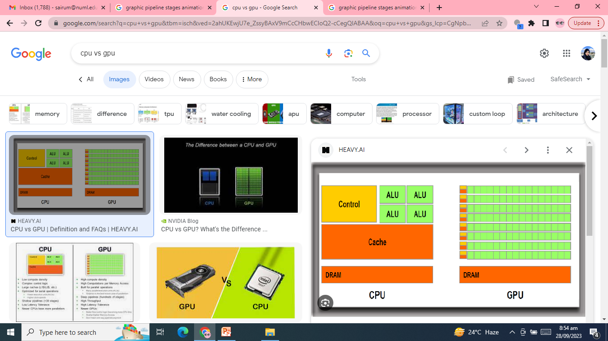

Slide 5
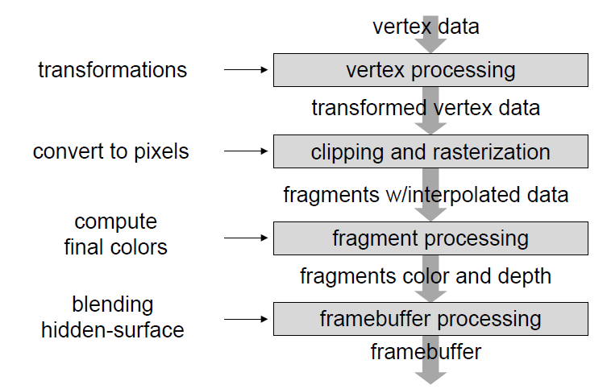
Graphics Pipeline Stages
Instructor: Sabina Irum
Notes:
The most basic rasterization algorithm takes a 3D scene, described as polygons, and renders it onto a 2D surface, usually a computer monitor. Polygons are themselves represented as collections of triangles. At a very basic level, rasterizers simply take a stream of vertices, transform them into corresponding 2-dimensional points on the viewer’s monitor and fill in the transformed 2-dimensional triangles as appropriate.
Transformations are usually performed by matrix multiplication.
The main transformations are translation, scaling, rotation etc.
Vertex processing - converts each vertex to a 2D screen position.

Slide 6
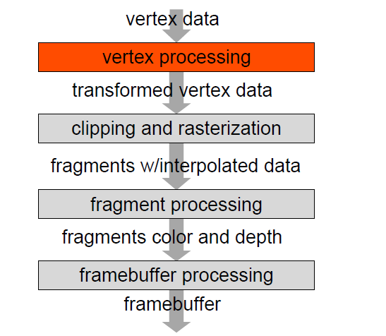
Vertex processing
  Input: vertex data (position, color, etc.)
  Output: transformed vertices in respective object and colors, etc.
Instructor: Sabina Irum
Notes:
The function of the vertex pipeline in any GPU is to take geometry data (usually supplied as vector points), work with it if needed and (create all of the 3D data points in a scene to a 2D plane for display on a computer monitor.
It is possible to eliminate unneeded data from going through the rendering pipeline to cut out extraneous work (called view volume clipping and backface culling). After the vertex engine is done working with the geometry, all the 2D calculated data is sent to the pixel engine for further processing such as texturing and fragment shading.

Slide 7
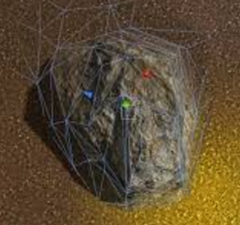
Vertex processing
Other geometry tasks
  deformation: skinning, mesh blending
  low-quality lighting
  pass other properties to next stages of pipeline
  the only place to algorithmically alter shape
Programmable hardware unit
  algorithm can be changed at run-time by application
  only recent change
Instructor: Sabina Irum

Slide 8
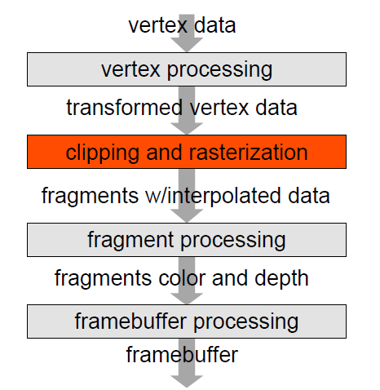
Clipping and rasterization
Clipping
  turns sets of vertices into primitives and fills them in
  output: set of fragments with interpolated data.
  Rasterisation
  Process in which a vector graphics format (shapes) and converting it into a raster image (pixels or dots) for output on a video display or printer,
  or for storage in a bitmap file format.
Instructor: Sabina Irum
Notes:
Rasterisation is a process in which a vector graphics (shapes) are converted into a raster image (pixels or dots)
Clipping: Clipping is the process of trimming triangles to fit them inside the viewing area (viewing Window).
The most common technique is the Sutherland-Hodgeman clipping algorithm.

Slide 9
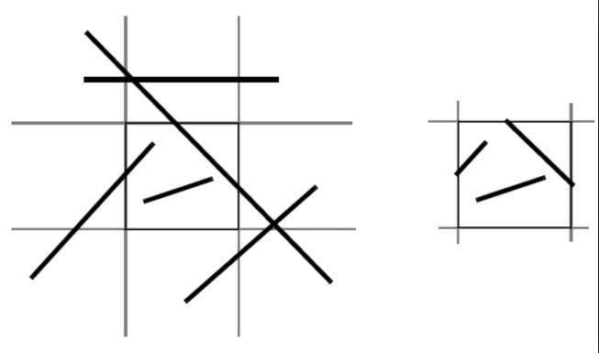
Clipping
Remove (partial) objects not in the view frustum
  efficiency: cull later stages of the pipeline
  often referred as culling when full objects removed
Instructor: Sabina Irum

Slide 10
Rasterization
approximate primitives into pixels
  pixel centered at integer coordinates
determine which pixels to turn on
  no antialiasing (jaggies) pixel in the primitive
  consider antialiasing for some primitives
  input: vertex position in homogenous coordinates
interpolate values across primitive
  colors, position at vertices
  input: any vertex property
Instructor: Sabina Irum
Notes:
Antialiasing is the smoothing of the image roughness caused by aliasing . With images, approaches include adjusting pixel positions or setting pixel intensities so that there is a more gradual transition between the color of a line and the background color.
Means sooth the blocky pattern (stairsteps)
NO antialising means .. Alising . preimitive will have stair step case look

Slide 11
Rasterization
required properties
  uniform thickness and brightness
  continuous appearance (no holes)
  Efficiency
  simplicity (for hardware implementation)
Instructor: Sabina Irum

Slide 12
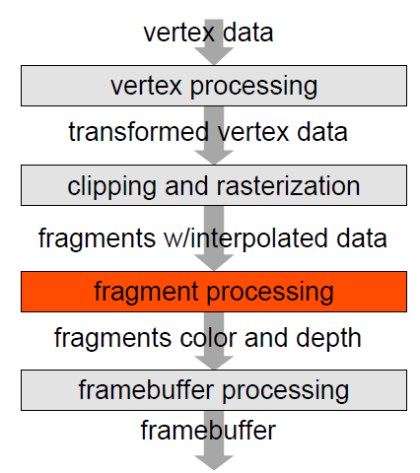
Fragment processing
Fragment processing
  output: final color and depth
  traditionally mostly for texture lookups
Lighting was computed for each vertex
  today, computes lighting per-pixel
Instructor: Sabina Irum

Slide 13
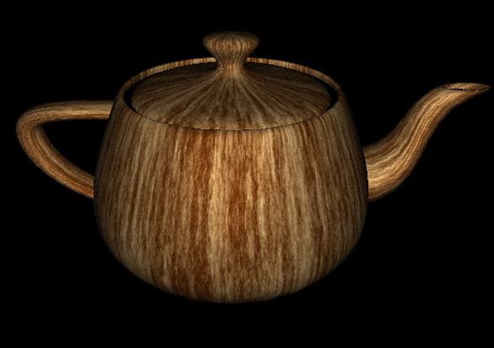
Fragment processing
Compute final fragment colors, alphas and depth
  depth is often untouched if no special effects
  final lighting computations
  lots of texture mapping
Texture Mapping
Instructor: Sabina Irum
Notes:
Alpha is used to specify the transparency, with alpha of 0 for totally transparent and alpha of 1 for opaque

Slide 14
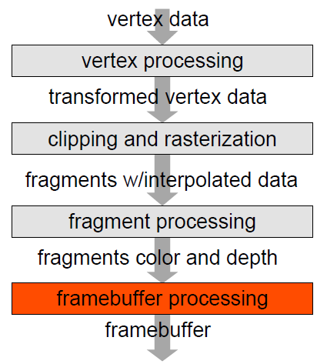
Frame buffer processing
Frame buffer processing
  output: final picture
  hidden surface elimination
Instructor: Sabina Irum

Slide 15
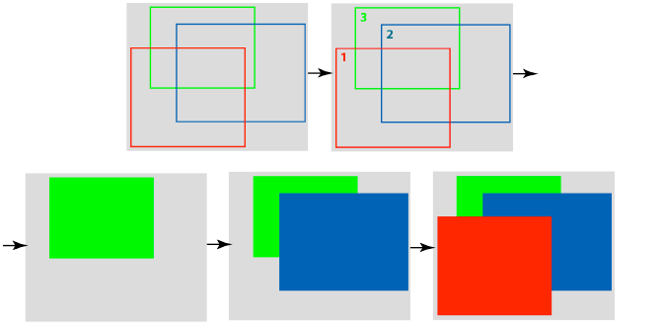
Frame buffer processing
Hidden surface removal
  sort objects back to front
  draw in sorted order
  does not work in many cases
Instructor: Sabina Irum
Notes:
Correct visibility – when multiple opaque polygons cover the same screen space, only the closest one is visible (remove the other hidden surfaces)

Slide 16
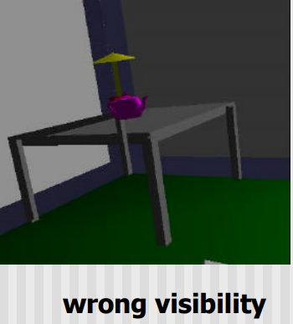
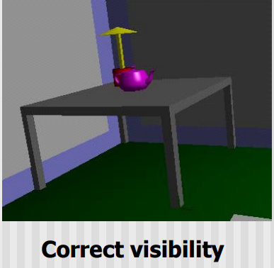
Hidden surface removal

Slide 17
Rendering
Rendering is the process of generating an image from a model, by means of computer programs.
The model is a description of three-dimensional objects in a strictly defined language or data structure
Model would contain geometry, viewpoint, texture, lighting, and shading information.
The image is a digital image or raster graphics image.
Instructor: Sabina Irum

Slide 18
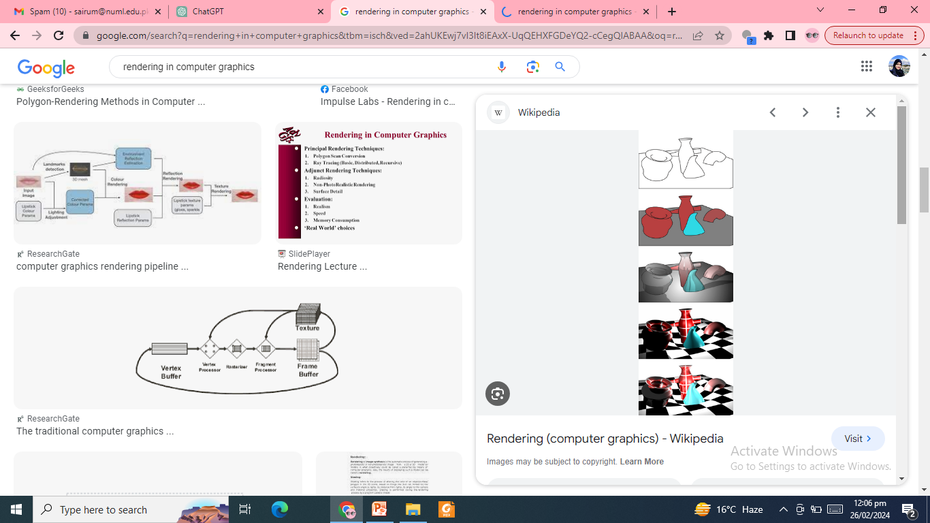

Slide 19
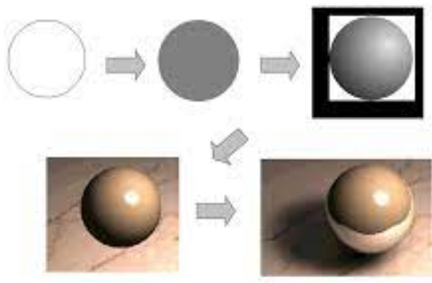

Slide 20
Features of Rendered Image
shading — how the color and brightness of a surface varies with lighting
texture-mapping — a method of applying detail to surfaces
fogging/participating medium — how light dims when passing through non-clear atmosphere or air
shadows — the effect of obstructing light
soft shadows — varying darkness caused by partially hidden light sources
Instructor: Sabina Irum

Slide 21
Features of Rendered Image
reflection — mirror-like or highly glossy reflection
Transparency or opacity — sharp transmission of light through solid objects
refraction — bending of light related with transparency
indirect illumination — surfaces illuminated by light reflected off other surfaces, rather than directly from a light source (also known as global illumination)
Instructor: Sabina Irum

Slide 22
Features of Rendered Image
motion blur — objects appear blurry due to high-speed motion, or the motion of the camera
non-photorealistic rendering — rendering of scenes in an artistic style, planned to look like a painting or drawing
Instructor: Sabina Irum
Notes:
Non photorealistic rendering provides wide variety of expressive styles for digital art

Slide 23
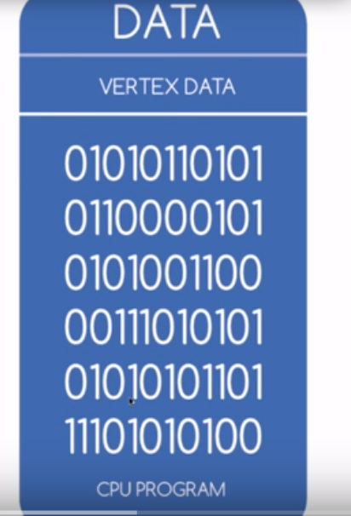
Vertex data
Instructor: Sabina Irum

Slide 24

Vector processing

Slide 25
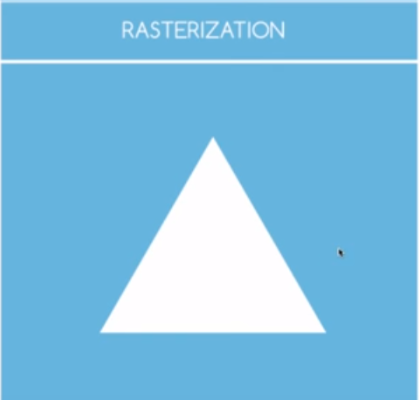
Rasterization
Instructor: Sabina Irum
Notes:
Smooting and multisampling

Slide 26


Fragment processing & Frame Buffer
Fragment Processing
Frame Buffer (output image in the form of pixels)

Slide 27
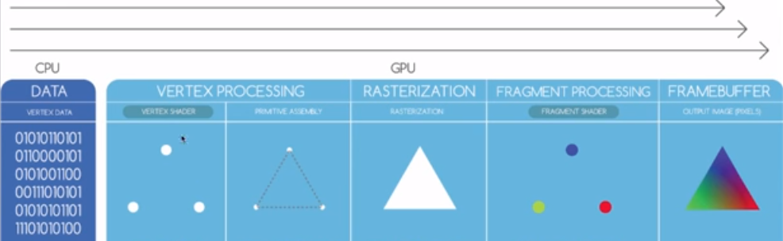
Pipeline Stages
Instructor: Sabina Irum

Slide 28
1
Which of the following is NOT a stage in the graphics pipeline?
a) Vertex Processing
b) Fragment Processing
c) Texture Mapping
d) Rendering
Notes:
d

Slide 29
2
The stage of the graphics pipeline responsible for transforming vertices from object space to screen space is called:
a) Vertex Processing
b) Rasterization
c) Fragment Processing
d) Texture Mapping
Notes:
a

Slide 30
3
Which stage of the graphics pipeline is responsible for determining which fragments are visible and should contribute to the final image?
a) Vertex Processing
b) Rasterization
c) Fragment Processing
d) Texture Mapping
Notes:
b

Slide 31
4
Which stage of the graphics pipeline involves applying textures to the surfaces of objects?
a) Vertex Processing
b) Rasterization
c) Fragment Processing
d) Texture Mapping
Notes:
c

Slide 32
5
In which stage of the graphics pipeline are pixels shaded and colored based on lighting conditions and surface properties?
a) Vertex Processing
b) Rasterization
c) Fragment Processing
d) Texture Mapping
Notes:
c

